Slide 1

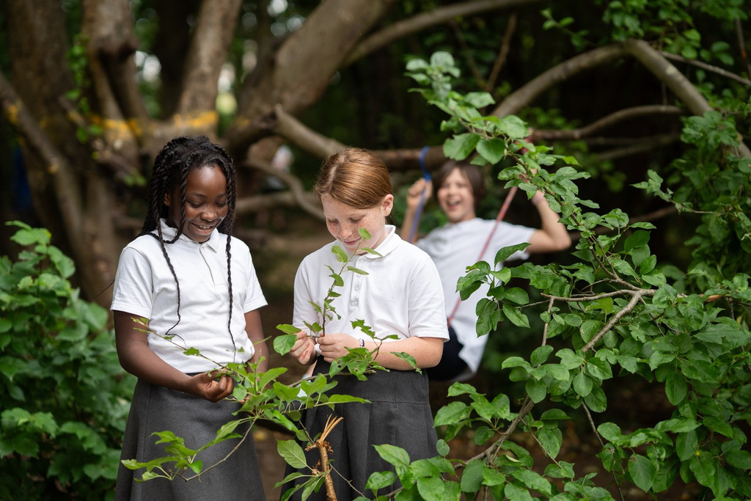


Welcome
to
Year 2
www.galleyhill.herts.sch.uk
01442 406000
Resilient, Curious, High Aspirations, Persevere

Slide 2

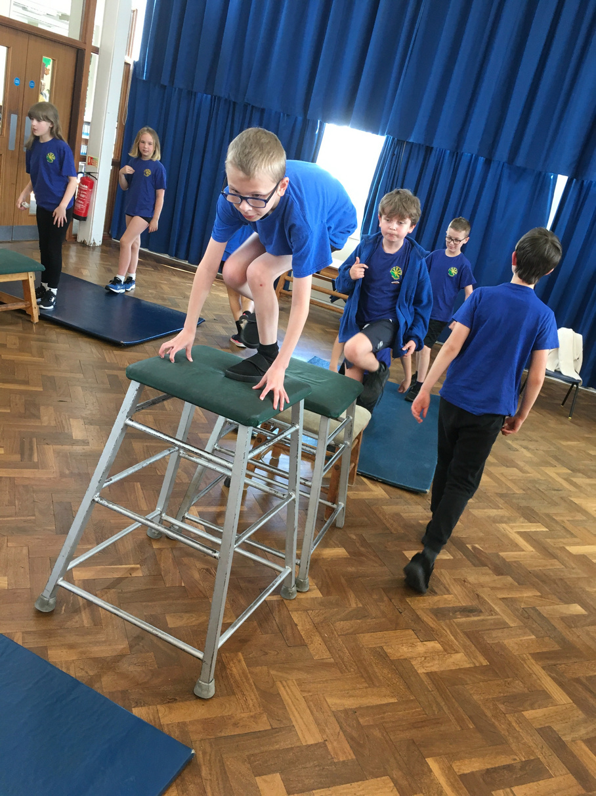
Team Pearl
Class Teacher: Miss Featherstone
Teaching Assistants: Mrs Lawrence
Team Diamond
Class Teacher: Miss Penning
Teaching Assistant: Ms Derham
Phase Leader: Mrs Reynolds
www.galleyhill.herts.sch.uk
01442 406000
Resilient, Curious, High Aspirations, Persevere
Notes:
Phase leader who you go to after teachers (not Head)

Slide 3
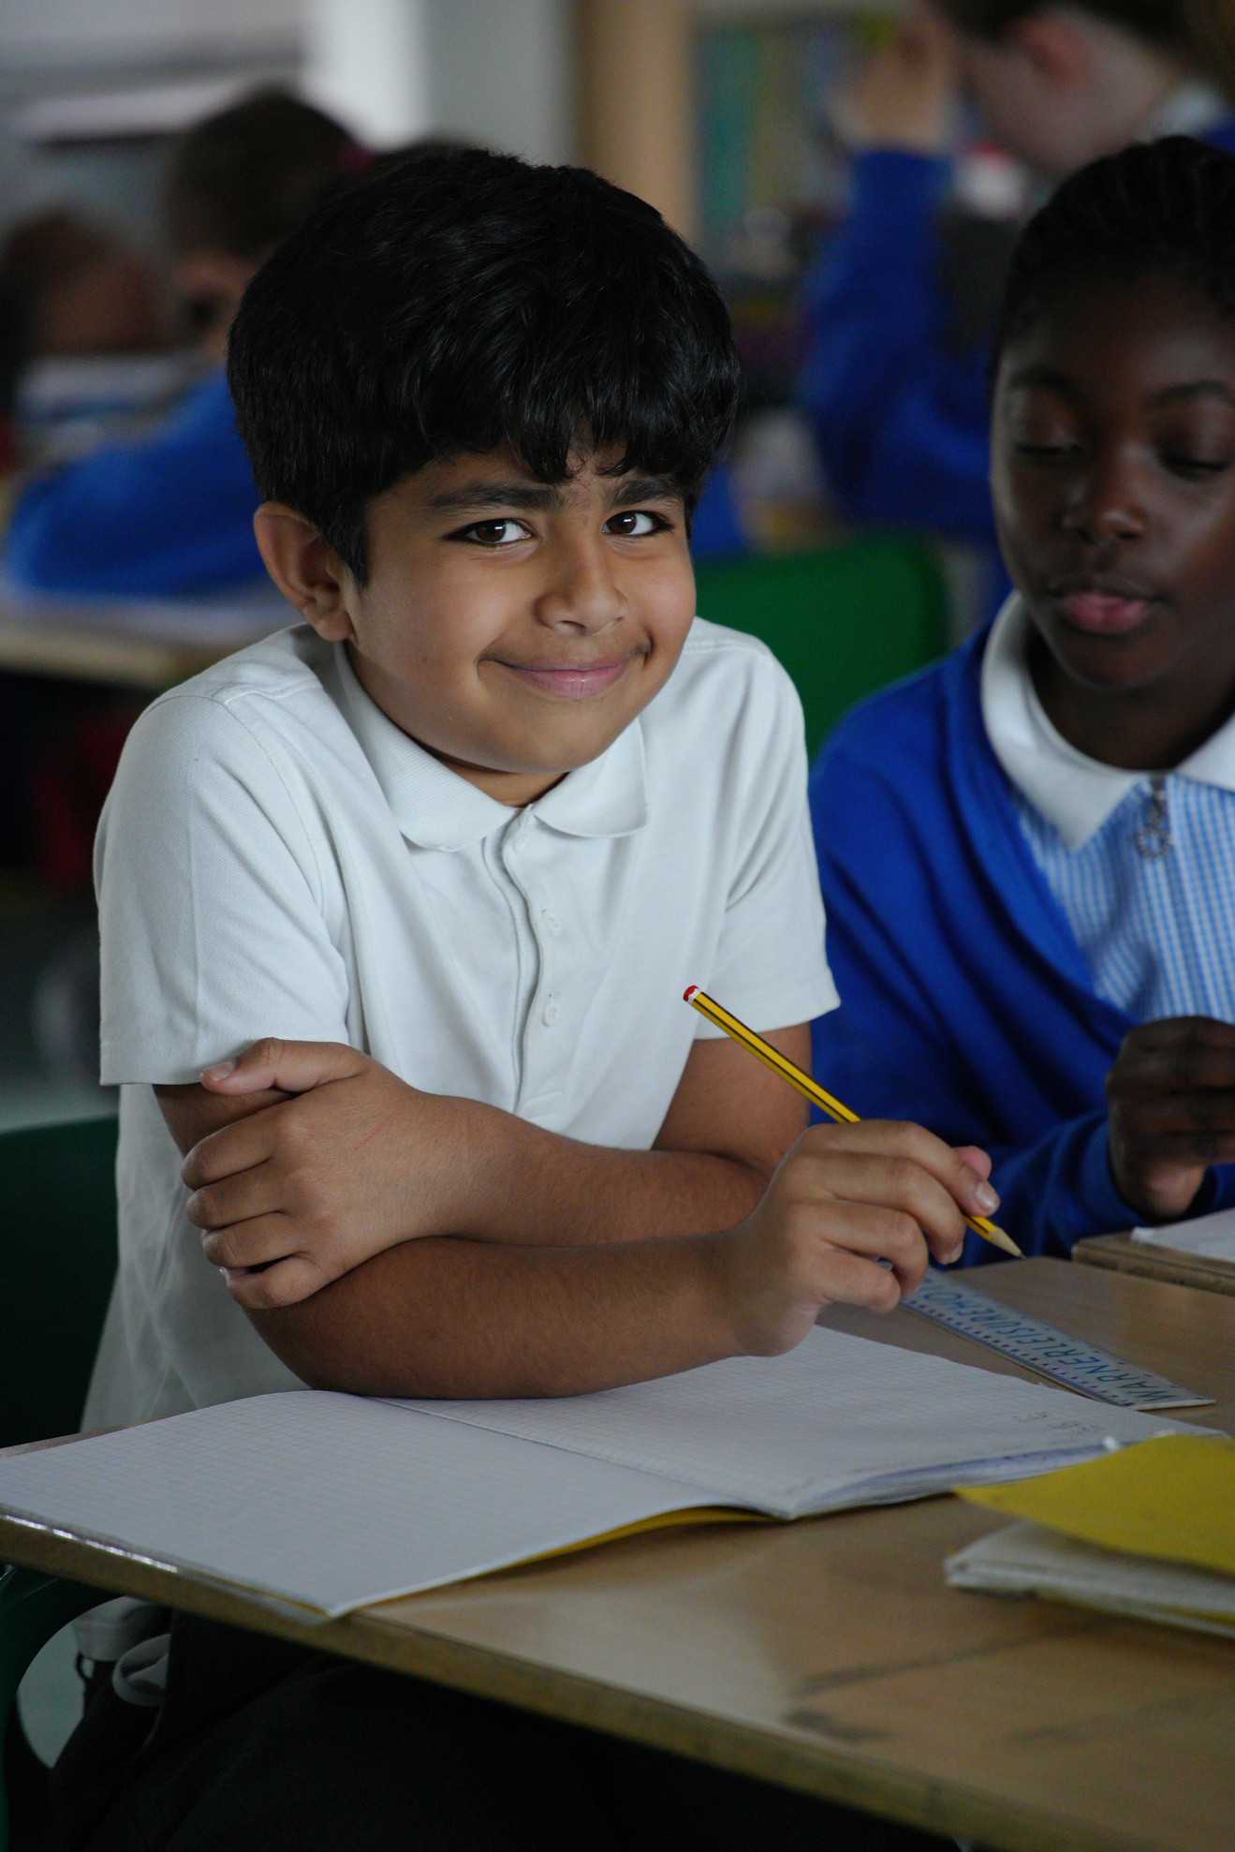

The Galley Hill Vision
Our vision is to develop
resilient learners who:
are curious about the world around them.
have high aspirations for themselves and the wider world.
persevere to achieve their goals .
www.galleyhill.herts.sch.uk
01442 406000
Resilient, Curious, High Aspirations, Persevere

Slide 4
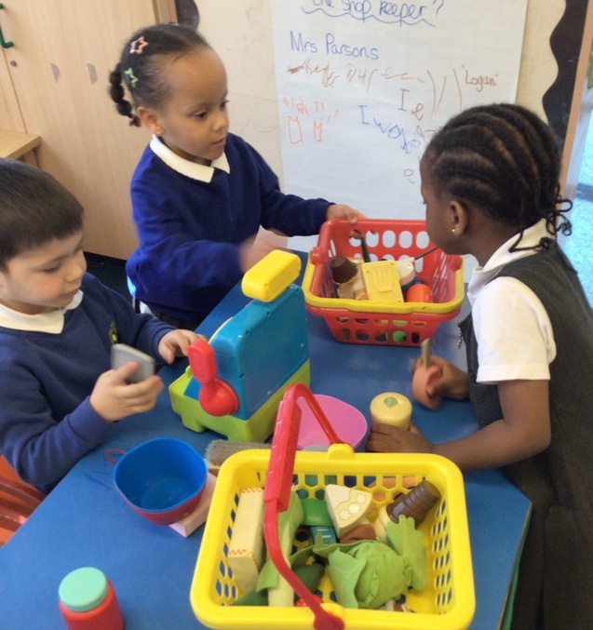

www.galleyhill.herts.sch.uk
01442 406000
Resilient, Curious, High Aspirations, Persevere

Slide 5
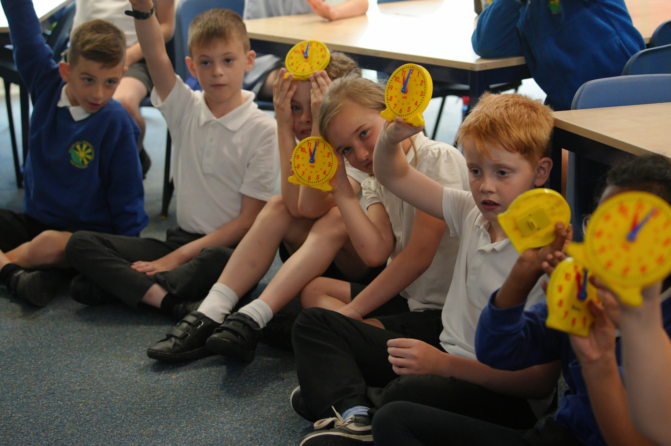
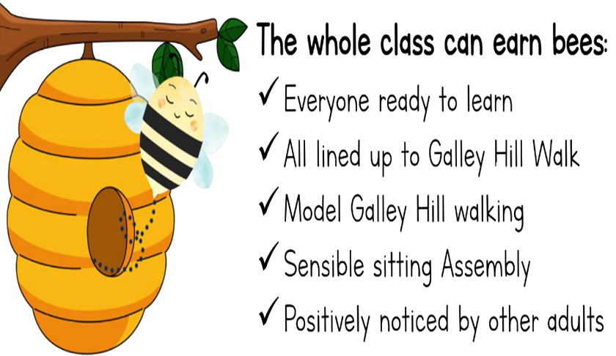



Rewards
www.galleyhill.herts.sch.uk
01442 406000
Resilient, Curious, High Aspirations, Persevere

Slide 6
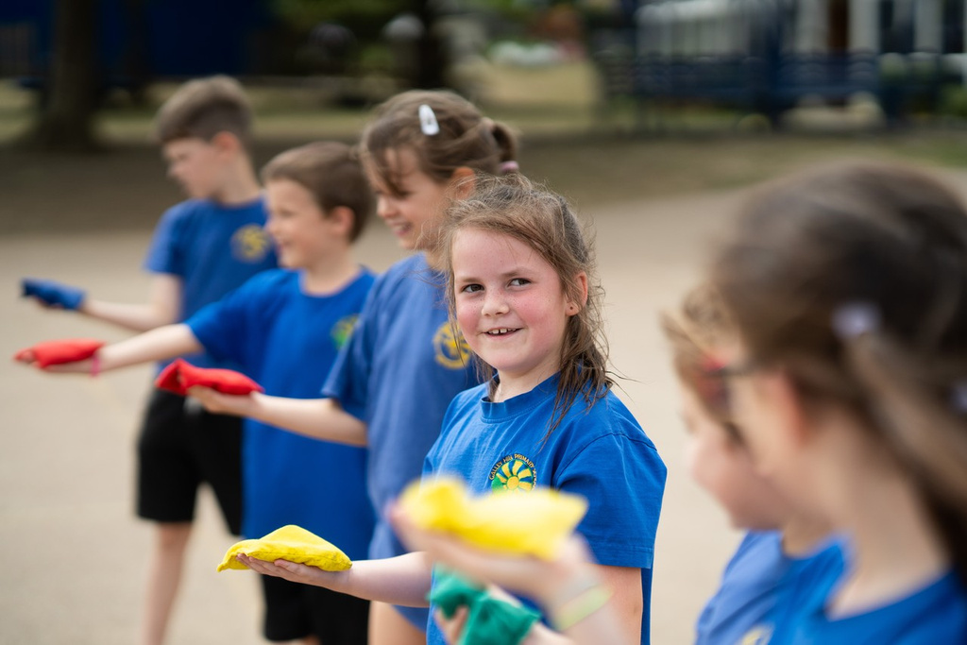




School Uniform
White Polo Shirt or Shirt/Blouse
Blue/White Gingham Dress (Summer)
Royal Blue Fleece/Sweatshirt or Cardigan
Charcoal Grey/Black Skirt/Pinafore Dress
Charcoal Grey/Black Trousers or Tailored Shorts
Grey/Black or White Socks,
Grey/Black/Navy Blue Tights
Black Shoes/Black Trainers
www.galleyhill.herts.sch.uk
01442 406000
Resilient, Curious, High Aspirations, Persevere

Slide 7
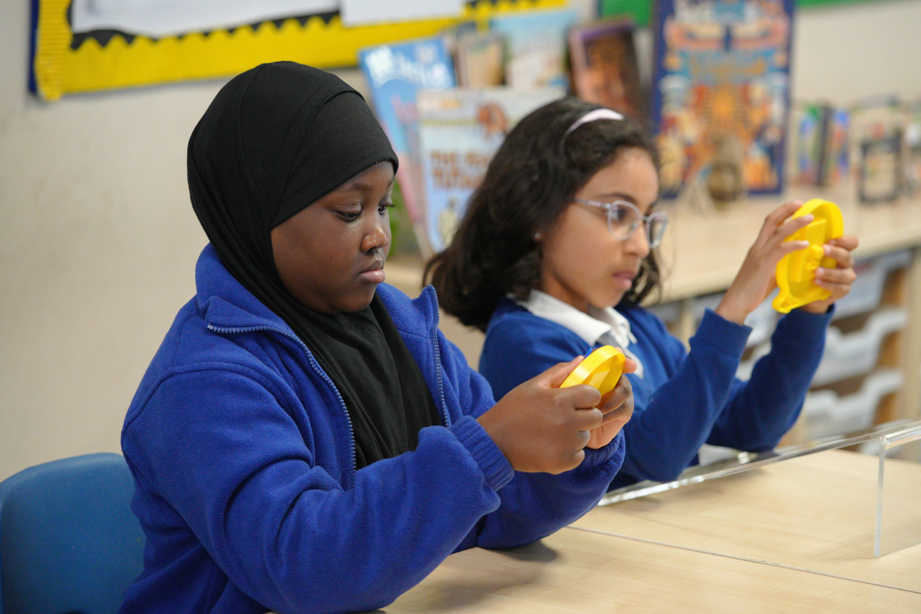
School Uniform
Jewellery
One pair of small plain stud earrings.
Surgical/micropore tape should be used to cover any earrings during PE.
Hair
Any pupils with long hair has it tied back.
Hair accessories should be discrete.
Extreme hairstyles, hair colour, any nail varnish or tattoos are not acceptable within the school.
www.galleyhill.herts.sch.uk
01442 406000
Resilient, Curious, High Aspirations, Persevere
Notes:
Jewellery
Galley Hill Primary School follow the Hertfordshire guidance on the wearing of jewellery. For Health & Safety reasons no jewellery should be worn in school, if your child has pierced ears, one pair of small plain stud earrings will be allowed. Surgical tape should be used to cover any earrings during PE, this must be applied by parent/carer on the day of your child’s PE lesson unless your child is capable of applying this themselves. Teachers cannot remove or replace earrings. If your child has earrings in and no tape to cover them on PE days, they will be asked to remove them and we will keep them safe in an envelope to take home.
Hair
We ask that any pupil with long hair has it tied back neatly during the school day. Hair accessories should be discrete.
Extreme in hairstyles, hair colour, any nail varnish or tattoos are not acceptable within the school.

Slide 8
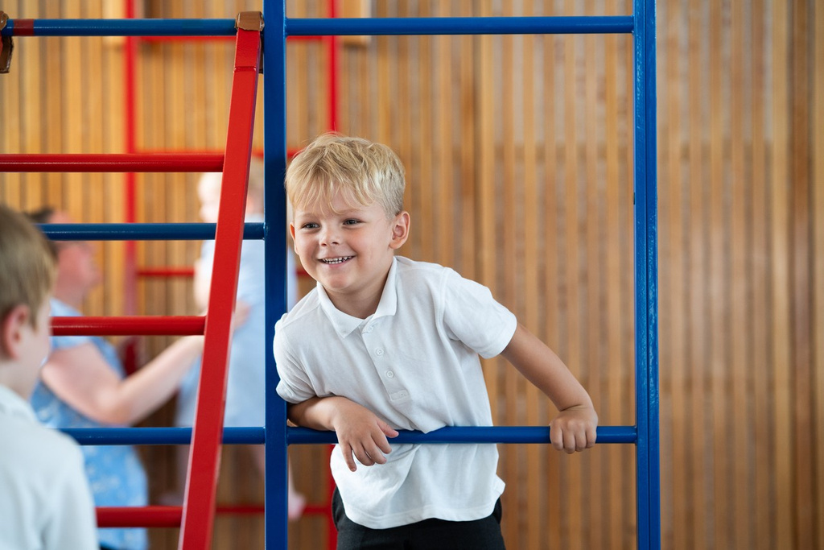



Physical Education
Our Autumn P.E. days are:
Team Pearl: Tuesday & Wednesday
Team Diamond: Tuesday & Wednesday
Children come to school dressed in their PE kits on their PE days.
P.E. Kit (Please ensure this is always in school in a named bag)
Royal Blue T-shirt (preferably with school logo)
Black Shorts
Black/Navy tracksuit for Autumn/Spring Term
Trainers for use on the field or playground
www.galleyhill.herts.sch.uk
01442 406000
Resilient, Curious, High Aspirations, Persevere

Slide 9
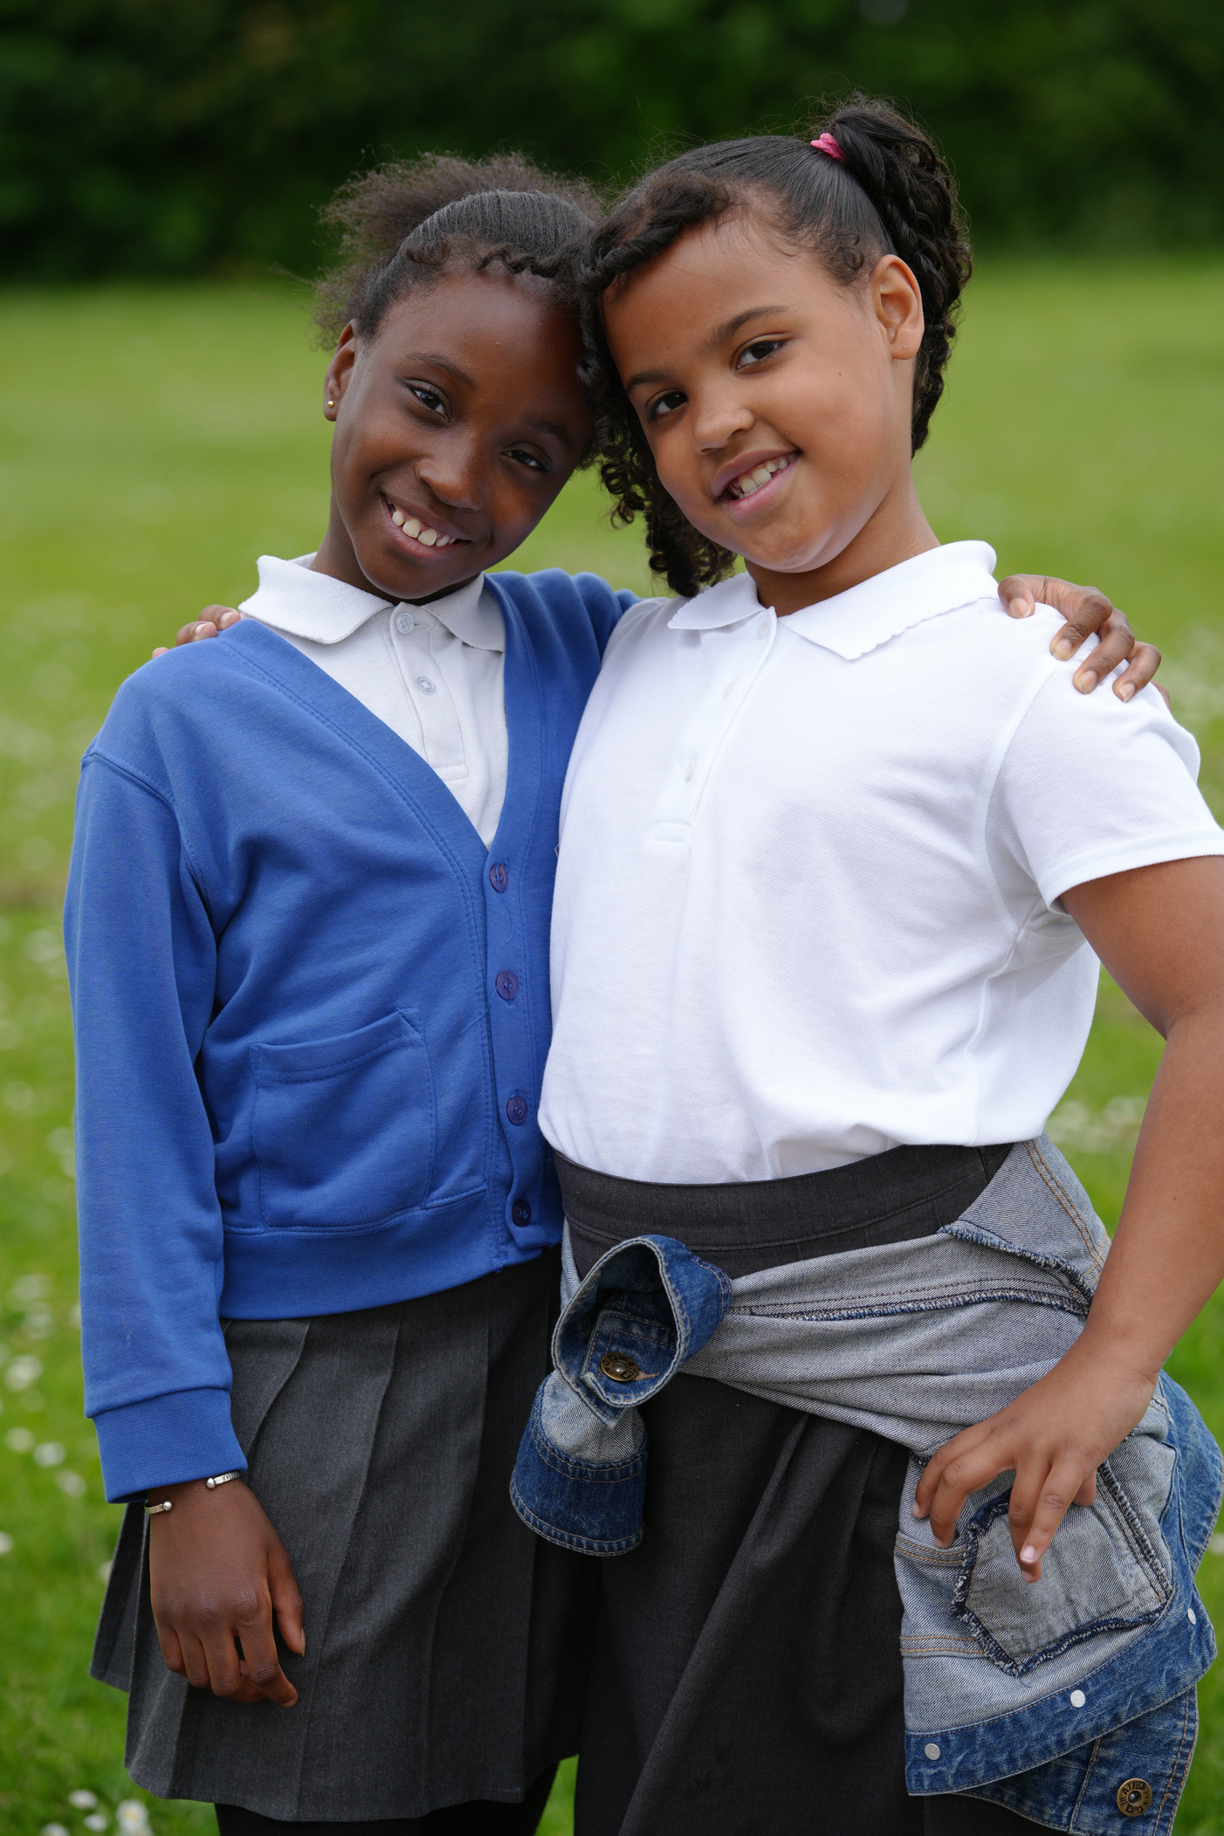

As an OPAL Platinum School children use the outside even in wet weather.
They require a raincoat (and trousers if they wish). To play on the field they require welly boots.
We have a wide range of resources outside for your child to play with but are always looking for donations to add to our OPAL fun.
www.galleyhill.herts.sch.uk
01442 406000
Resilient, Curious, High Aspirations, Persevere
Notes:
Children across the school are encouraged outside in all weathers including wet weather - provided they have an appropriate waterproof coat (and trousers if they so wish).
It has been decided that to go onto the grass or mud areas at breaktime or lunchtime, children will need to be wearing wellies – old shoes will no longer be allowed – this is ensure that the bottoms of trousers, tights and socks stay dry and mud free.
We have a wide range of resources outside for your child to play with but are always looking for donations to add to our OPAL fun.

Slide 10
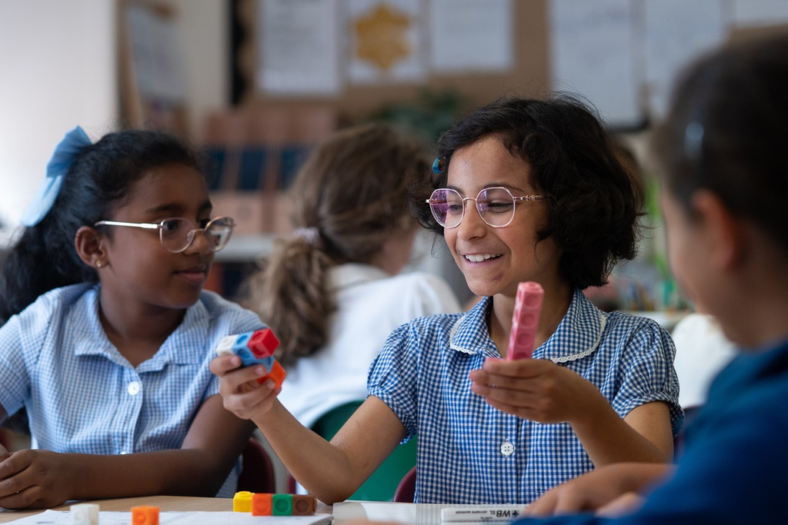
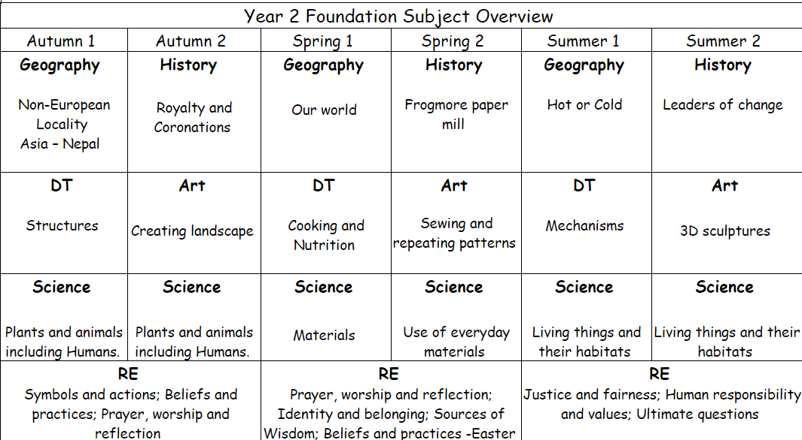
Curriculum Overview
www.galleyhill.herts.sch.uk
01442 406000
Resilient, Curious, High Aspirations, Persevere

Slide 11
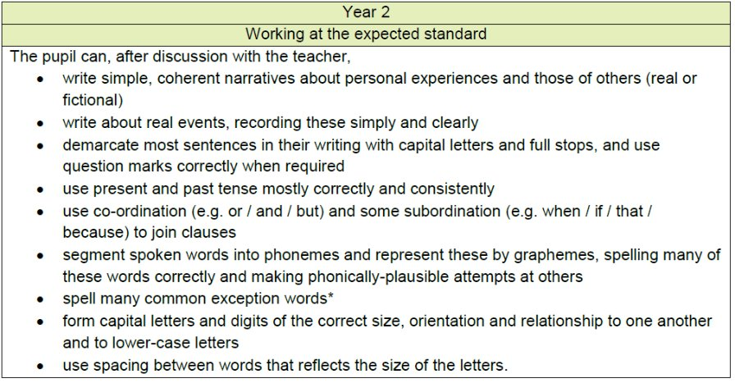
Writing
www.galleyhill.herts.sch.uk
01442 406000
Resilient, Curious, High Aspirations, Persevere

Slide 12
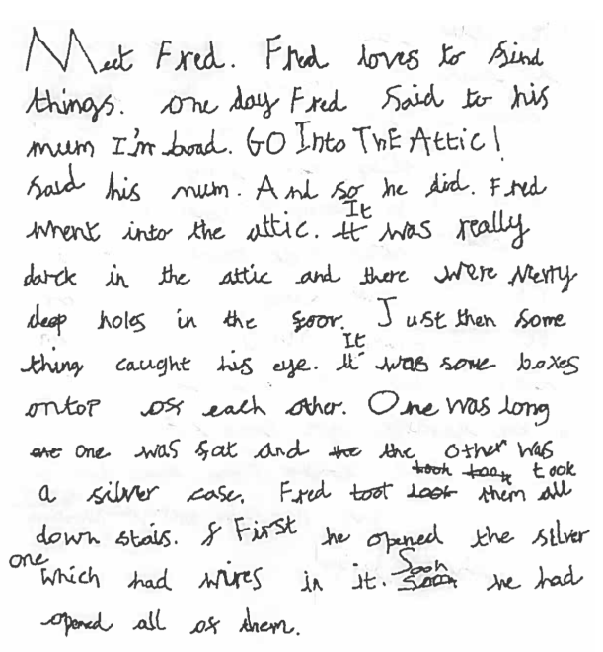
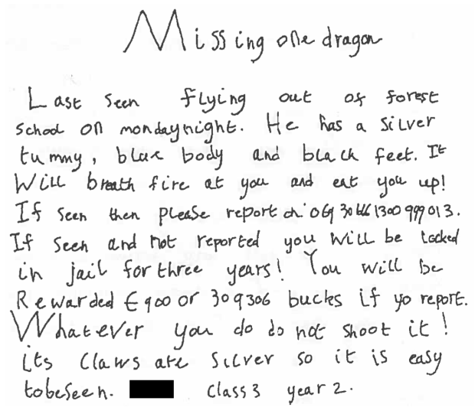
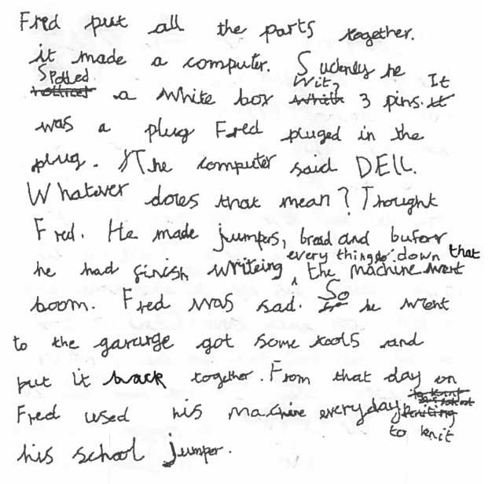
www.galleyhill.herts.sch.uk
01442 406000
Resilient, Curious, High Aspirations, Persevere

Slide 13
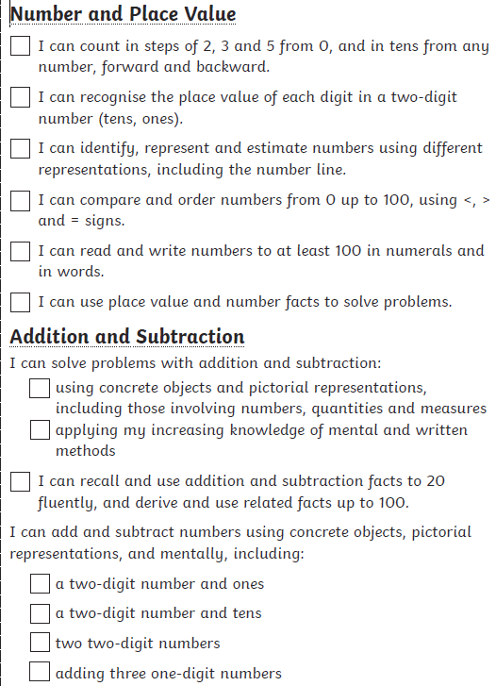
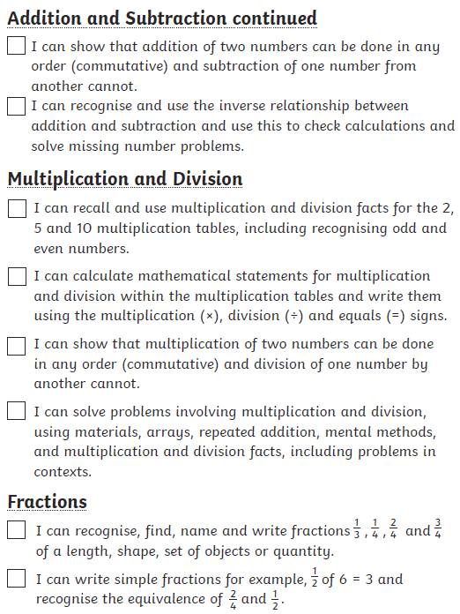
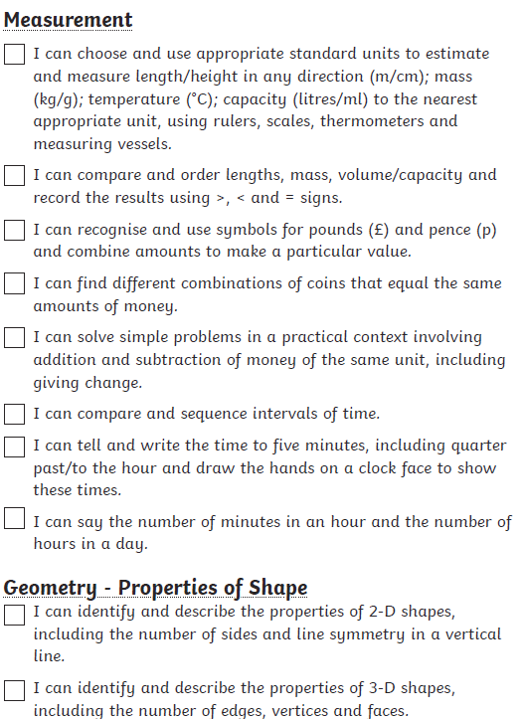
Maths
www.galleyhill.herts.sch.uk
01442 406000
Resilient, Curious, High Aspirations, Persevere

Slide 14
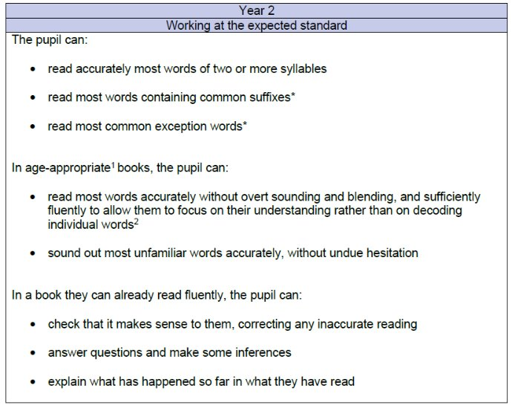
Reading
www.galleyhill.herts.sch.uk
01442 406000
Resilient, Curious, High Aspirations, Persevere

Slide 15

School Trips
In Autumn we go to Windsor Castle, this trip
costs approx.
In Summer, we are hoping to go to the Paper Mill if it is open.
If you wish to pay for this trip over the whole year on arbor you are able to make frequent payments to them over the whole year vs paying in a quick deadline when letters come out.
www.galleyhill.herts.sch.uk
01442 406000
Resilient, Curious, High Aspirations, Persevere

Slide 16
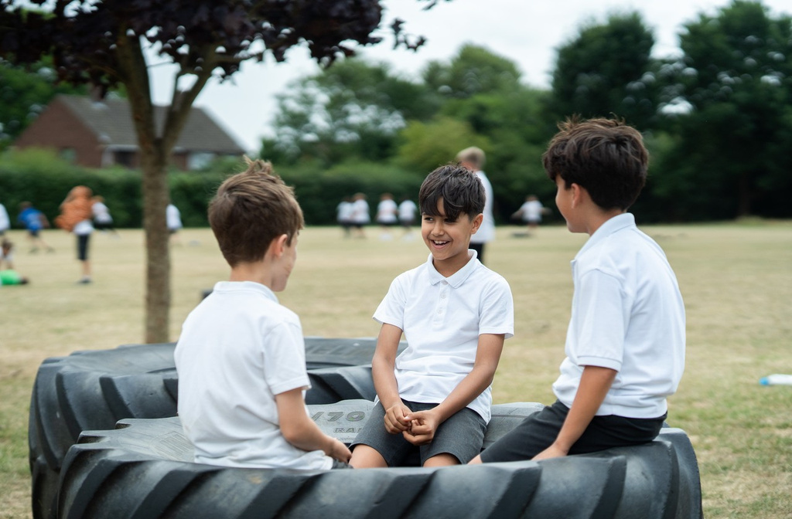
Statutory Assessment
If a child did not meet the expected standard for the Phonics Screener assessment in year 1 will be retested.
www.galleyhill.herts.sch.uk
01442 406000
Resilient, Curious, High Aspirations, Persevere
Notes:
last academic year we had a practise test in the Autumn Term and then children took the formal assessment in June – We believe the same dates will apply this year.
If they do not meet the expected standard again, they will not need to retake in Year 3.

Slide 17
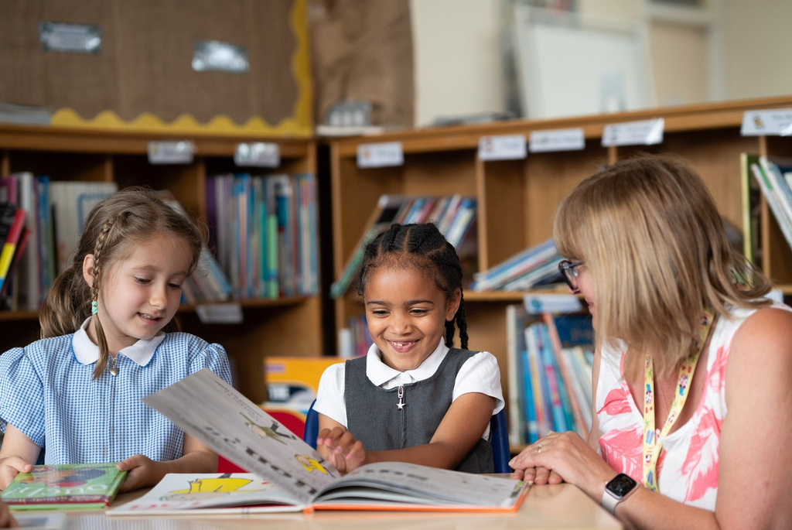
Reading
Read with them as regularly as possible (at a minimum we would suggest 4 x a week).
When your child needs a new book they should put their wallet containing their reading record and finished book into the reading box.
Reading records should be handed in on homework day, they will be checked to see how often your child has read. Either you or your child should complete the record every time they read; if your child fills their record in please sign it to say you agree.
www.galleyhill.herts.sch.uk
01442 406000
Resilient, Curious, High Aspirations, Persevere
Notes:
The best thing you can do to support your child with their learning is read with them as regularly as possible (at a minimum we would suggest 4 x a week). Even in year 4 this is vital and the children do gain a lot from reading out loud to an adult who can correct any mistakes, answer questions, discuss the text or look up an unknown word together.
When your child needs a new book they should put their wallet containing their reading record and finished book into the reading box. It is their responsibility to be asking for a new book and we will be monitoring that children are changing books.
Reading records should be handed in on homework day, they will be checked to see how often your child has read. Either you or your child should complete the record every time they read; if your child fills their record in please sign it to say you

Slide 18
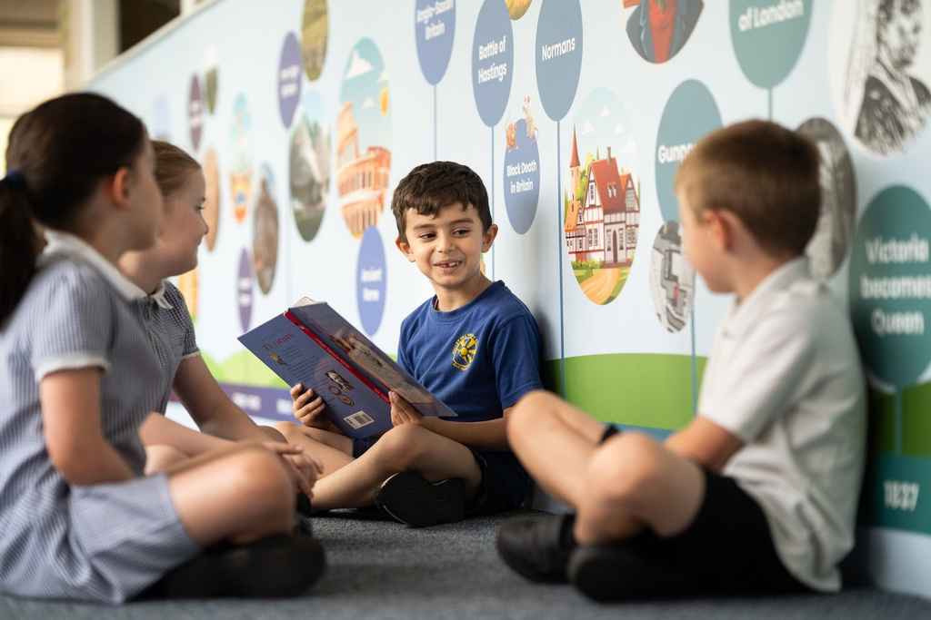
The Importance of Reading
From babies to children in their early years and all the way through to early teens, reading brings wide-ranging benefits that can have a lifelong positive impact on children’s lives.
If a child is never read to they will have heard approximately 4,662 words by the time they are 5 years old.
If a child is read to or reads 1-2 times per week, they will have heard approximately 63,570 words by the time they are 5 years old.
If a child is read to or reads 3-4 times per week, they will have heard approximately 169,525 words by the time they are 5 years old.
If a child is read to or reads daily, they will have heard approximately 296,660 words by the time they are 5 years old.
Reading for pleasure unlocks academic success across the curriculum. A child who is read to at age 1-2 scores higher in reading, spelling, grammar, and numeracy skills at age 8-11.
Reading for pleasure at the ages of 10 and 16 has a substantial effect on a child’s cognitive scores in vocabulary, spelling, and mathematics at age 16
www.galleyhill.herts.sch.uk
01442 406000
Resilient, Curious, High Aspirations, Persevere

Slide 19
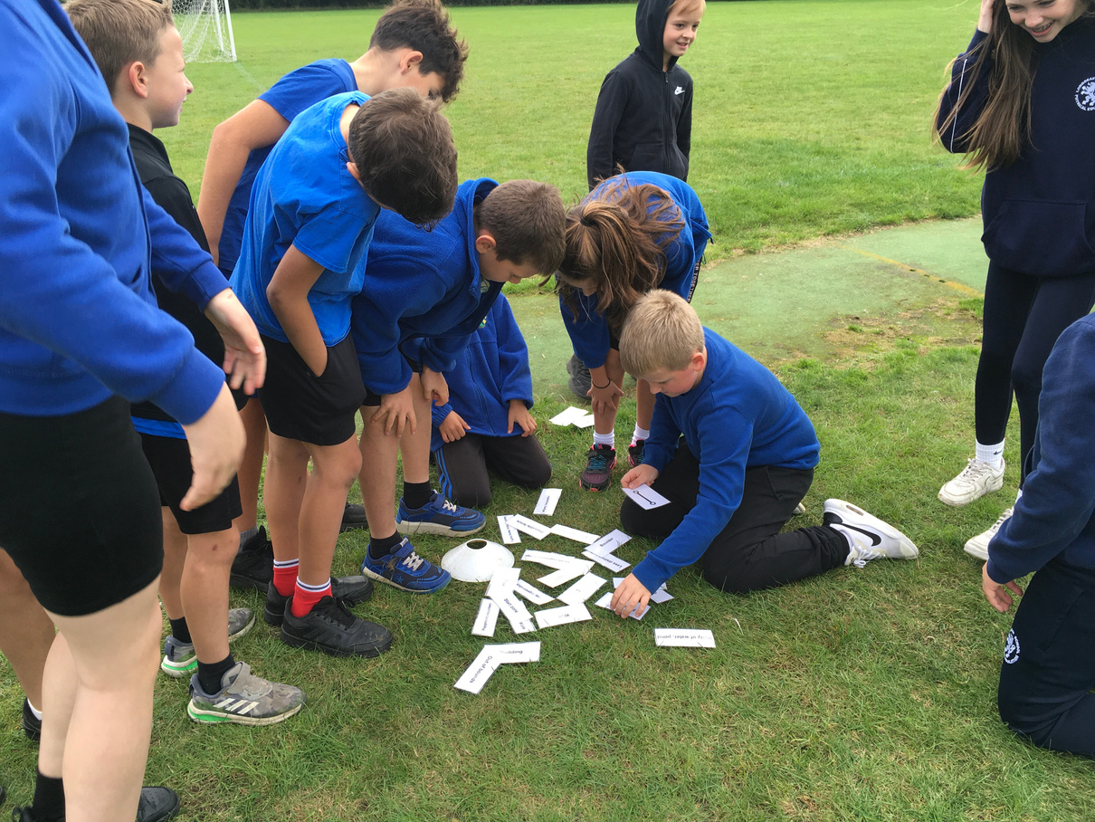
Homework
Year 2 will receive the following homework:
  Reading 4 x each week
  Maths – The children will receive times tables homework linked to the year 2 targets of 2, 5 and 10 times tables.
  Times tables rockstars is an optional extra.
  TTRS login in their reading records.
  Phonics – Supersonic Phonic Friends Newsletter to practice sounds taught that week
It will be set on a Friday and should returned the following Wednesday.
Homework stickers are earnt for completed work,
1 sticker for every day they read,
when completed earn a badge.
www.galleyhill.herts.sch.uk
01442 406000
Resilient, Curious, High Aspirations, Persevere
Notes:
l be a new times tables weekly reward in celebration assembly for children who are trying their best with their times tables.

Slide 20
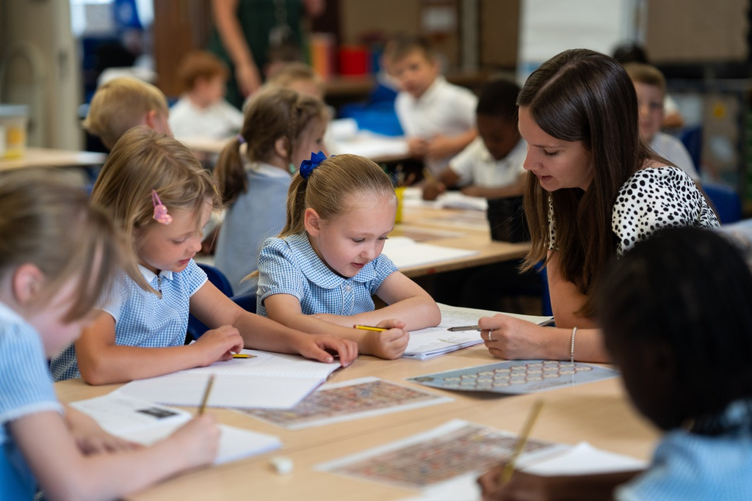
What to bring to school?
Your child must bring:
Named water bottle.
A reading book and reading record in the named plastic wallet provided.
Children should be provided with weather specific items when appropriate such as sun hats or gloves.
The children should NOT bring any pencil cases, games, toys, trading cards etc from home. The school will not take responsibility for any items brought into school.
www.galleyhill.herts.sch.uk
01442 406000
Resilient, Curious, High Aspirations, Persevere
Notes:
The children must bring their reading book and reading record to school, in the named plastic wallet previously provided, every day. This will enable children to read with an adult when the opportunity presents itself.
Children should be provided with weather specific items when appropriate such as sun hats or gloves. Suncream is permitted but this must be applied by your child themselves and not shared with friends.
All children should have a named water bottle every day.
Named P.E. kits should be left on their peg and will be sent home at the end of a half term to be washed, please bring a clean kit back on the first day after each holiday.
The children should NOT bring any games, toys, trading cards etc from home. The school will not take responsibility for any items brought into school.

Slide 21
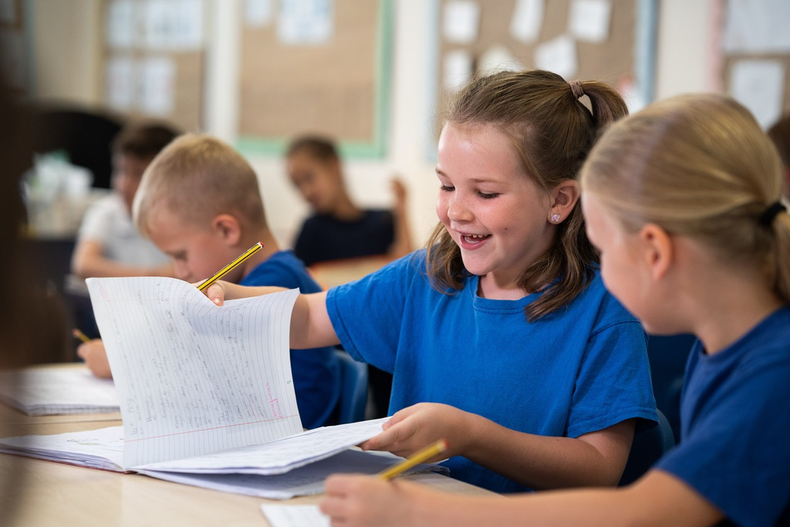
Timetable
Arrive between 8:40am and 8:45am
After that time, they will be late
and will need to enter through
the school office.
Our school day ends at 3:15pm.
An overview of our timetable will be on the website shortly.
www.galleyhill.herts.sch.uk
01442 406000
Resilient, Curious, High Aspirations, Persevere

Slide 22
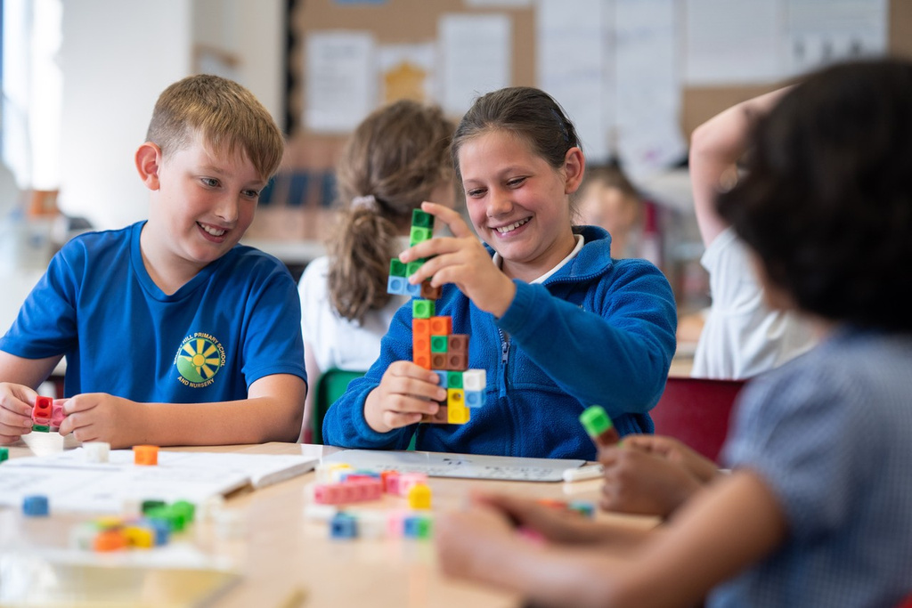
Eating and Drinking
Year 2 are provided with fruit every break.
You can send in your own healthy snack (whole / pieces of fruit, vegetables or bread sticks) to eat at break time. ​
Named water bottle - contain water, flavoured water or squash.
​
If your child is going to be late for school but will need school dinner, please let the school office know by 9:30am.
www.galleyhill.herts.sch.uk
01442 406000
Resilient, Curious, High Aspirations, Persevere
Notes:
children will need to bring in a healthy snack (whole / pieces of fruit, vegetables or bread sticks) to eat at break time. ​
They should have a named water bottle in school everyday. This should ideally contain still, plain water but children can have flavoured water and squash if they would prefer. ​
Each morning, the children will be asked their school dinner option or if they are having a packed lunch. ​
If your child is going to be late for school but will need school dinner, please let the school office know by 9:30am.

Slide 23
Attendance
To meet government expectations must attend 177 out of 190 days.
Concerns for any pupil whose attendance drops below 90%.
If your child is genuinely too ill for school, please email admin@galleyhill.herts.sch.uk or call and leave a message on our 24 hour answerphone as soon as possible. For safeguarding reasons, we will chase any absence we do not have a reason for.
We can only authorise term time holiday in very exceptional circumstances. Please see our absence policy on our website.
www.galleyhill.herts.sch.uk
01442 406000
Resilient, Curious, High Aspirations, Persevere
Notes:
Children need to attend school for at least 177 out of 190 days to meet national expectations.
We are extremely concerned for any pupil whose attendance drops below 90%.
If your child is genuinely too ill for school, please email the admin address or call and leave a message on our 24 hour answerphone as soon as possible. For safeguarding reasons, we will chase any absence we do not have a reason for.
We can only authorise term time holiday in very exceptional circumstances. Please see our absence policy on our website

Slide 24

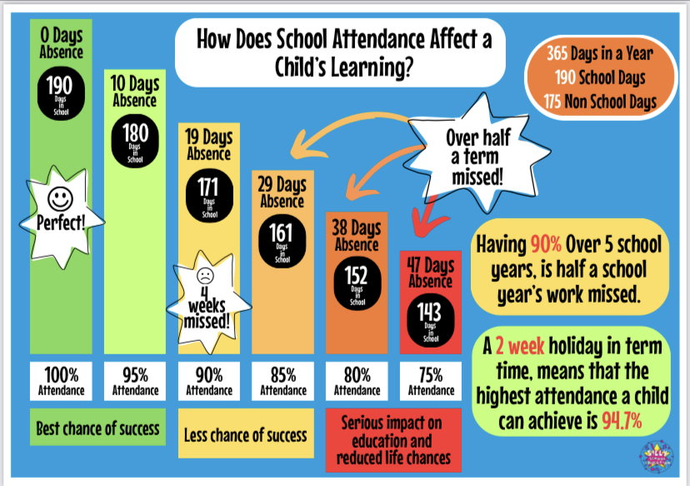
www.galleyhill.herts.sch.uk
01442 406000
Resilient, Curious, High Aspirations, Persevere

Slide 25
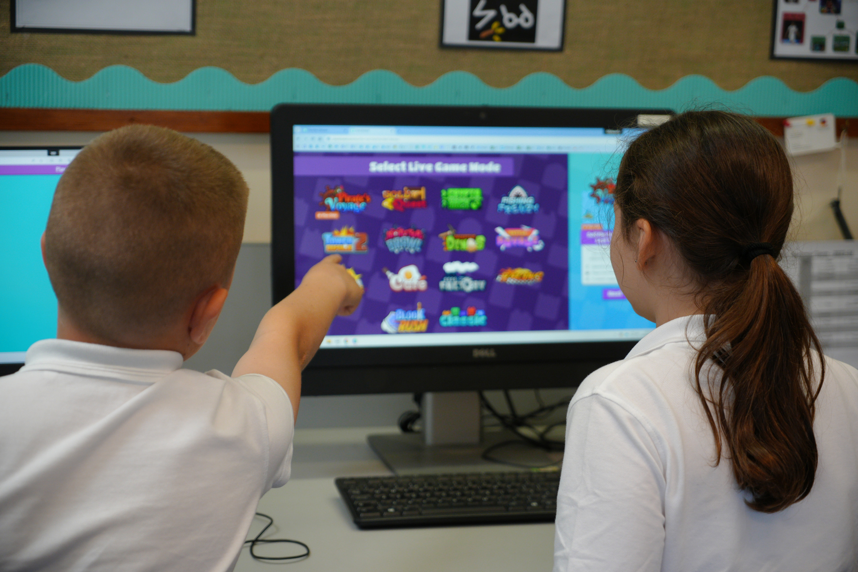

Arbor
Download app from play store or app store.
Used to make payments for meals, trips and clubs.
Can pre-pay for trips if it suits.
All communications will come via Arbor also.
www.galleyhill.herts.sch.uk
01442 406000
Resilient, Curious, High Aspirations, Persevere
Notes:
Visit the app store or play store and download
the 'Arbor' app. You can then log in with the
details you have created and you should be all
logged on and ready to go!
You will need the app to make payments for
Trips/Clubs/Meals and all communications will
start to be coming through Arbor only so to make
sure you know what is going on, please download!

Slide 26
Thank you for taking the time to join us for this welcome meeting.
If you have any further questions, then please do come and speak to us now.
www.galleyhill.herts.sch.uk
01442 406000
Resilient, Curious, High Aspirations, Persevere

